Slide 1
SWANLAND PRIMARY SCHOOL
INFORMATION FOR PARENTS
Maths Mastery
Information and support strategies
November 2020

Slide 2
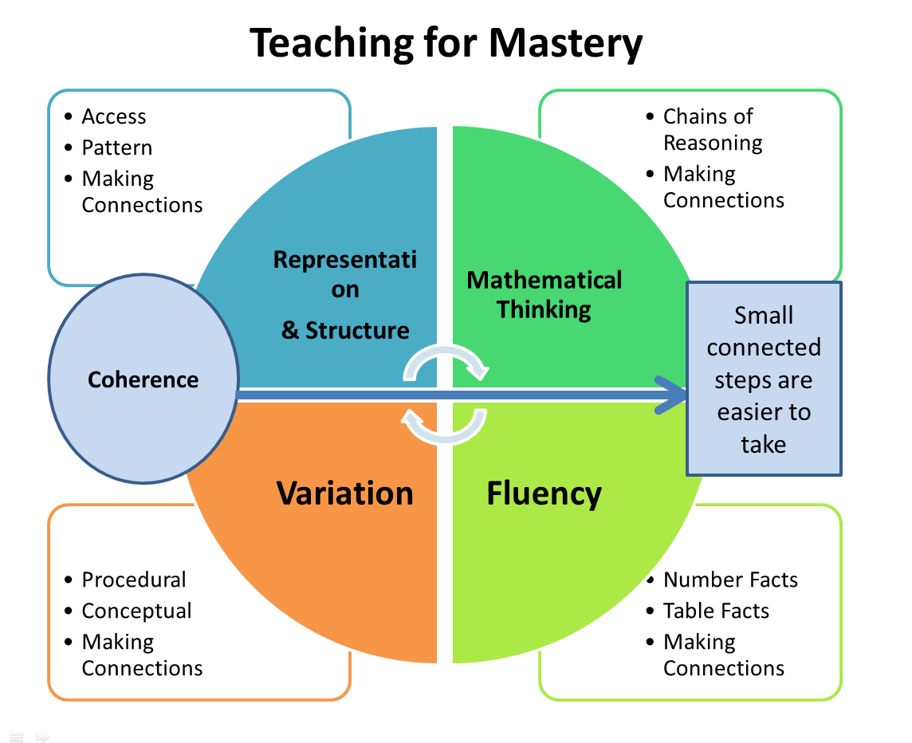
SWANLAND PRIMARY SCHOOL | INFORMATION FOR PARENTS

Slide 3
Key Ideas
The class will be working together on the same topic.
Rapid (same day) intervention where required from teachers and teaching assistants.
Challenge is provided through deepening understanding rather than accelerating knowledge acquisition.
Small steps to ensure the children understand the concepts rather than a method.
SWANLAND PRIMARY SCHOOL | INFORMATION FOR PARENTS

Slide 4
Key Ideas
Classes will spend longer on teaching each topic – rather than revisiting multiple times within the year.
SWANLAND PRIMARY SCHOOL | INFORMATION FOR PARENTS

Slide 5
Key Ideas
No ability groupings – however children can progress quickly to more difficult problems
Problem solving and reasoning skills are developed to ensure children have a deeper understanding
SWANLAND PRIMARY SCHOOL | INFORMATION FOR PARENTS

Slide 6
Reception – Year 5
These year groups follow the mastery approach
Classes spend longer on individual topics and really develop a secure knowledge and understanding
Children work together on the same objective and develop fluency, reasoning and problem solving skills
Children are challenged through the use of reasoning and problem solving
Children are encouraged to understand the calculations through concrete and pictorial representation
SWANLAND PRIMARY SCHOOL | INFORMATION FOR PARENTS

Slide 7
Year 6
Year 6 spend the year consolidating all the methods developed and secured during maths lessons in previous years.
They look at the specific needs of the cohort and provide support and challenge in these areas (this can vary from year to year).
Due to the formal SATs tests in May, the children are required to develop their skill in order to be equipped to answer the questions.
They develop abstract methods and formal written methods for calculations.
SWANLAND PRIMARY SCHOOL | INFORMATION FOR PARENTS

Slide 8
Pupils need to work at a much greater depth in order to solve problems, reason and explain.
SWANLAND PRIMARY SCHOOL | INFORMATION FOR PARENTS

Slide 9
SWANLAND PRIMARY SCHOOL | INFORMATION FOR PARENTS

Slide 10
Concrete Apparatus
Concrete apparatus can be used by all children (not just KS1 or children who are struggling)
Useful to develop the understanding of numbers (rather than looking at the abstract approach)
Using resources can develop rich mathematical vocabulary and develop understanding of concepts
SWANLAND PRIMARY SCHOOL | INFORMATION FOR PARENTS

Slide 11
Bar Model – pictorial representation
Bar models can be used to develop understanding of many different types of questions.
Useful when trying to solve problems – extracting information.
They are just one way of representing a question or problem pictorially.
SWANLAND PRIMARY SCHOOL | INFORMATION FOR PARENTS

Slide 12
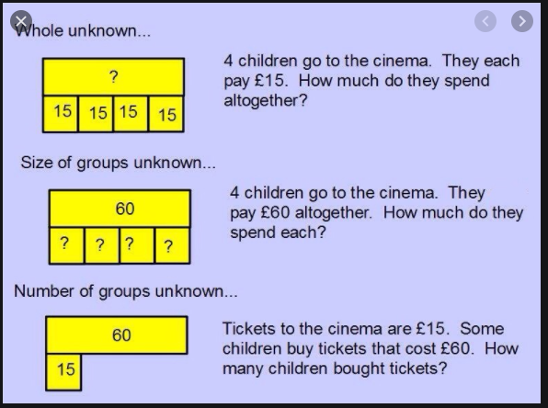
Bar Model – pictorial representation
SWANLAND PRIMARY SCHOOL | INFORMATION FOR PARENTS

Slide 13
Abstract
When children fully understand a concept they are able to understand the abstract representation
This skill develops throughout the school years (and before)
Children will continually revisit each aspect
SWANLAND PRIMARY SCHOOL | INFORMATION FOR PARENTS

Slide 14
Video link
https://youtu.be/PgrF1TYXP6Y
SWANLAND PRIMARY SCHOOL | INFORMATION FOR PARENTS

Slide 15
Classroom Ethos
Positive attitude – something for everyone.
Being able to make mistakes and learning from them.
Growth Mindset – helping others in the class.
Rich language – STEM sentences and regular discussion
Building confidence to be able to answer a range of questions and understand key concepts
SWANLAND PRIMARY SCHOOL | INFORMATION FOR PARENTS

Slide 16
Coverage
Each year group will cover the objectives for that year.
Eg. Year 4 will work on the Year 4 curriculum (this will be the case for most children).
Any greater depth activities will be problem solving based and linked to the year group objectives.
Children will be encouraged to reason and explain answers – proving and using strategies.
SWANLAND PRIMARY SCHOOL | INFORMATION FOR PARENTS

Slide 17
How to help
When children are struggling – use a concrete representation. This doesn’t have to be a specific maths resource, use cars, toys, items found on a nature walk (anything goes!).
Encourage a visual representation – support the children to draw out their ideas and thinking when answering questions.
SWANLAND PRIMARY SCHOOL | INFORMATION FOR PARENTS

Slide 18
How to help
Working through similar questions together – support initially and slowly step back to enable independence to develop.
Speaking to the class teacher (either face to face or via SeeSaw) for advice on specific methods taught in each year group.
Each year group will share specific strategies the children are working on to support any learning at home.
SWANLAND PRIMARY SCHOOL | INFORMATION FOR PARENTS

Slide 19
Any questions? ? ?
Please raise your hand and I will do my best to answer the questions.
SWANLAND PRIMARY SCHOOL | INFORMATION FOR PARENTS

Slide 20
Thanks
https://www.youtube.com/watch?v=xkbQDEXJy2k
Maths is for everyone not just ‘mathsy’ people!
SWANLAND PRIMARY SCHOOL
Tranby Lane, Swanland, East Yorkshire, HU14 3NE | Telephone: 01482 631300
www.swanlandeducationtrust.co.uk

