Slide 1
SWANLAND PRIMARY SCHOOL
INFORMATION
FOR PARENTS
RESIDENTIAL VISIT
Dobroyd Castle
May

Slide 2
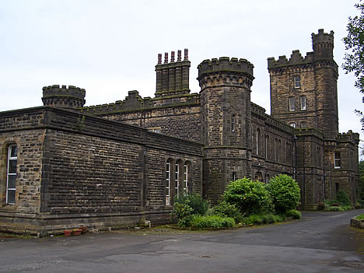
Dobroyd Castle
Todmorden
Lancashire.
1 hour 30 minutes from Swanland

Slide 3
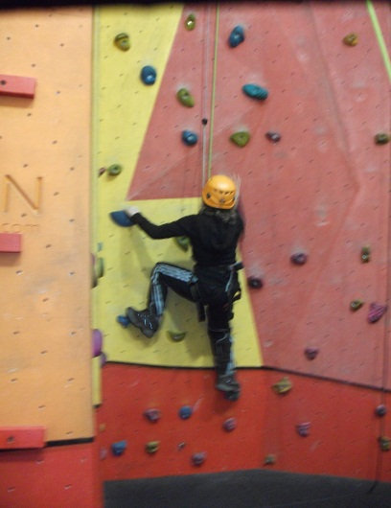
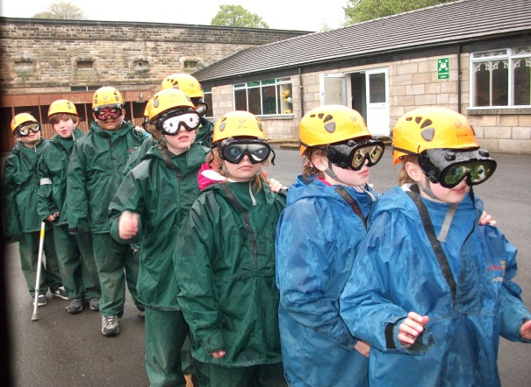
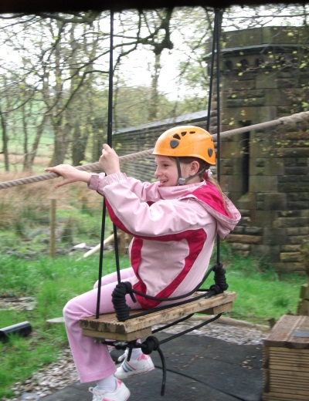
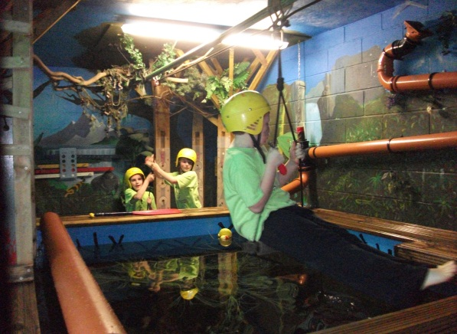
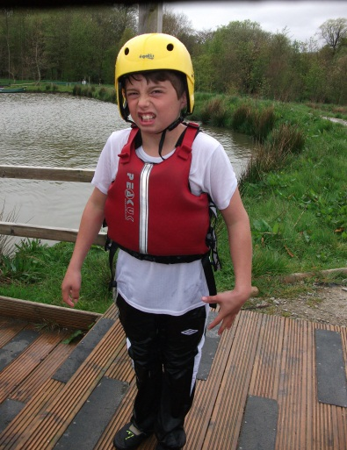
Activities
Can be found in
parent’s and children’s
information booklet.

Slide 4
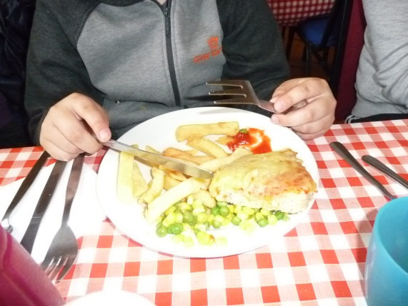
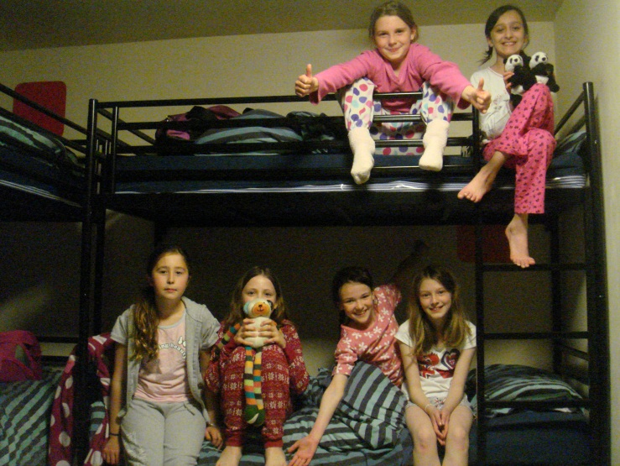
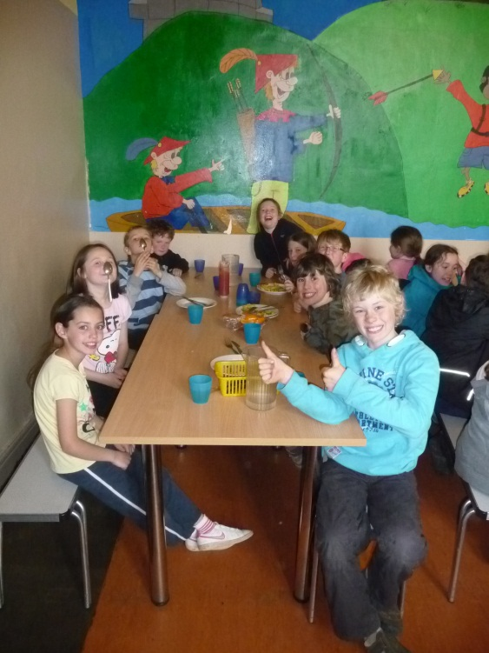
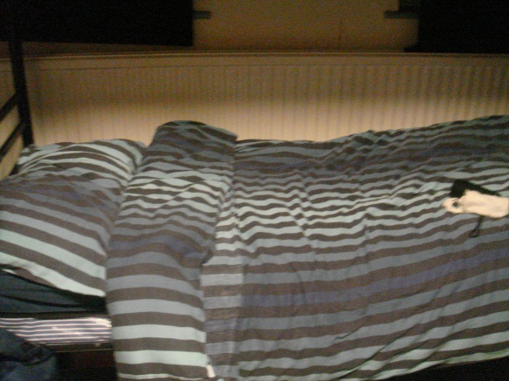
Accommodation
Can be found in
parent’s and children’s
information booklet.

Slide 5
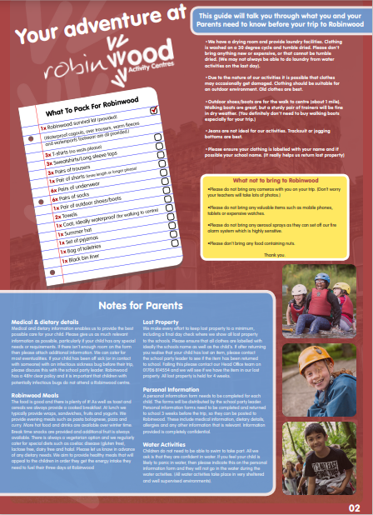
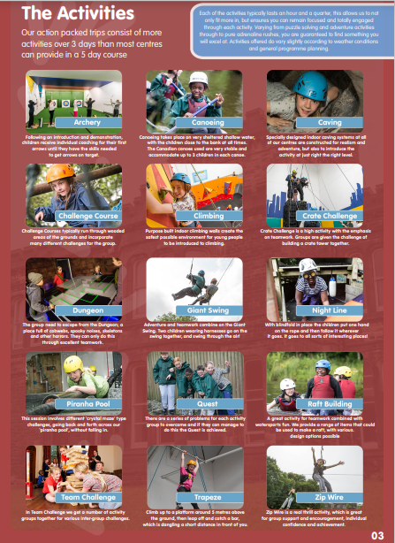
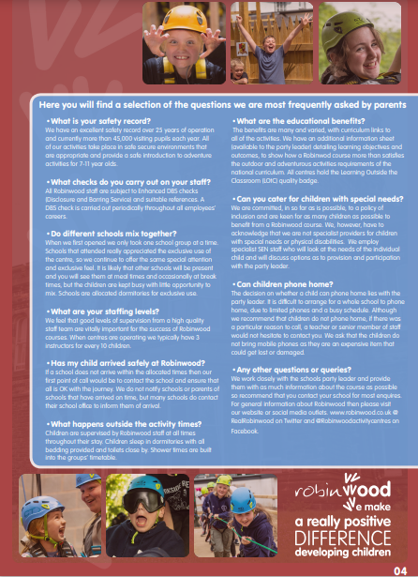

Slide 6
Costs
Includes;
travel, accommodation and insurance

